Slide 1


Sharing the planet
Overview
Rukia
Notes:
The last theme of IB.
Identity, social organization: small entities. Sharing the planet: discussing every questions/problems/phenomenon from the global perspective. We are talking about the problems which faced by all human beings.

Slide 2

Go to mentimeter.com, code: 5658 6398
Looking at the bigger picture:as a human being living on the earth, what are the challenges we are facing nowadays?
Climate change
racism
bullying
Poverty
Income inequality
Mental health issues
police brutality
homelessness
Covid-19
Travel Restrictions.
Notes:
Look at the bigger picture: To consider the general, overall, or long-term scope of something, as opposed to specific details or immediate preoccupations.
When we look closely to these issues, we find out all these issues happen in every corner of the world. E.g. climate change. It affects everyone in the world.
Unlike political issues, the air we breathe is not contained within any boundaries, like nationality or rivers. The pollutants of one country often harm another. So international cooperation is needed to solve such environmental problem.

Slide 3

With all the global issues above…..
Talk with your neighbors, which of the issue(s) has/have an impact/change to your life?
Give a specific experience or example
Then share with the whole class

Slide 4


Climate change & Global warming
What human activities contribute to the global warming?
In groups of 3/4, with your markers, everyone writes down at least one cause of global warming. No cause could be used more than once, and see how many causes can your group think of.
Once you have listed the causes of global warming, rank them in the order in which you think they contribute to the problem, from ‘greatest’ to ‘least’.
Notes:
Global warming is the most commonly known climate change trend worldwide.
Burning Fossil Fuels: largest source of greenhouse gas emissions from human activities. The combustion of coal, oil, and gas for electricity, heat, and transportation not only releases a large amount of CO2 but also other pollutants.
Deforestation: Trees absorb CO2, helping to reduce the amount of greenhouse gases in the atmosphere. Cutting down forests (deforestation) for agriculture, logging, and development reduces the number of trees available to absorb CO2, and the act of clearing the forest itself often involves burning, which directly releases CO2.
Agriculture: Agriculture, especially livestock farming, emits significant amounts of methane and nitrous oxide, gases with a much higher global warming potential than CO2. The use of synthetic fertilizers also releases nitrous oxide, a potent greenhouse gas.
Waste Management: Landfills produce methane as organic waste decomposes anaerobically (without oxygen). Inadequate waste management and treatment of waste can lead to significant releases of methane and CO2.
Energy Production: Aside from burning fossil fuels, the extraction and production of fossil fuels also release significant amounts of methane. Energy inefficiency and the flaring of gas during oil extraction contribute to this. (Dubai)
Urbanization and Transportation: The expansion of urban areas and the reliance on personal and commercial vehicles increase the consumption of fossil fuels, contributing to higher CO2 emissions. Transportation, including cars, trucks, airplanes, and ships, is a major source of global CO2 emissions.

Slide 5
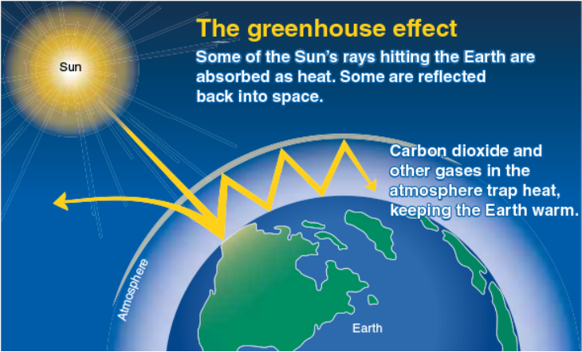
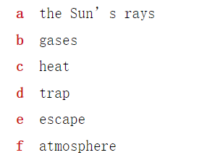

In your own words, give a brief explanation of how you think the greenhouse effect is created. How would you explain this concept to someone who knows nothing about global warming? Use the diagram below to support your explanation.
Notes:
The greenhouse effect is a natural process that warms the Earth's surface. When the Sun's rays reach the Earth, some of this energy is absorbed, warming the planet. The rest of the energy is reflected back towards space. However, certain gases in the Earth's atmosphere, known as greenhouse gases, trap some of this escaping heat. They act like a thermal blanket for the planet, holding in the heat that would otherwise escape back into space. This trapped heat helps to maintain the Earth's temperature at a level necessary for life as we know it.
The main greenhouse gases include carbon dioxide (CO2), methane (CH4), nitrous oxide (N2O), and water vapor. Without the greenhouse effect, the Earth's average temperature would be about -18°C (0°F), far too cold to support most forms of life. However, human activities, such as burning fossil fuels and deforestation, have increased the concentration of these greenhouse gases in the atmosphere. This enhancement of the natural greenhouse effect is leading to warmer temperatures on Earth, known as global warming, and is a major aspect of climate change.

Slide 6

The consequences
Climate change
Melting Ice and glaciers, increasing sea levels
Impact on Ecosystems and Biodiversity
Health issues
Agricultural impact
Notes:
Climate change: overall temperature rises, there will be more extreme weather (Above 40 Celcius)
Melting ice: coastal erosion, increased flooding, and threaten coastal communities and habitats.
Ecosystem: Changes in temperature and precipitation patterns can alter natural habitats. Some species may become endangered or extinct if they cannot adapt quickly enough, while others may spread and become invasive, further disrupting ecosystems.
Health risks: Higher temperatures and altered climate patterns can lead to increased health risks, including heat-related illnesses and deaths.
Agricultural: Climate change can affect crop yields, reducing food security. Some areas may benefit from longer growing seasons, while others may suffer from increased heat, drought, and pestilence, challenging global food supply and distribution.

Slide 7
The Hidden Cost of Hamburger
You are going to watch an online video called, “Hidden Cost of Hamburgers’ by Reveal.
Before you watch the video, read the questions on your worksheet and predict an answer for each question. Discuss your guess with your partners.
Then watch the video online. After listening carefully on the answers in the video, compare them to your original predictions. How similar were your predictions?
Notes:
https://www.google.com/search?q=the+hidden+cost+of+hamburgers&oq=tHE+HIDDEN+COST+OF+HAM&gs_lcrp=EgZjaHJvbWUqCQgAEAAYExiABDIJCAAQABgTGIAEMgYIARBFGDkyCAgCEAAYExgeqAIIsAIB&sourceid=chrome&ie=UTF-8#fpstate=ive&vld=cid:6214b397,vid:ut3URdEzlKQ,st:0

Slide 8
Animal agriculture
Animal agriculture is the husbandry of animals with the goal of producing food, fibers or other substances for human use.
Animal agriculture involves holding animals hostage simply so humans can eat their meat or their secretions, such as milk and eggs.
Notes:
Just a theory
Red meat–one of the biggest source of pollution
Breath, cut down trees, produce manure,
Africans blame China (disagree, we don’t eat that much meat)
Chinese foster livestock in African countries, so their environment has been affected.

Slide 9


Listening
Notes:
While there is no doubt that the climate change is caused by human activities and affecting all human beings, this topic is still debated continuously.

Slide 10

Cowspiracy: Before we watch it, answer these questions for yourself
What effect is anymal agriculture having on climate change？
How is animal agriculture connected to “deforestation, desertification
What are the environmental organizations doing about the problem of animal agriculture?
What do you think of ‘organic’ beef and dairy compared to ‘non-organic’ in terms of contributing to a more sustainable earth?
Would you ever consider becoming vegetarian or vegan? Would you consider participating in ‘meatless Mondays’?
Notes:
The ideas presented in the track are similar to those in the documentary “cowspiracy”
Forage grass–cut down trees
Mountain to mountain—time for grass to grow up
Wool, not just eat them, sheeps become more 2. Sheeps eat grass normally uprooting it, the land/soil become loose.
3. Only trees can protect the land—desert
restoring agricultural land forest
https://www.google.com/search?q=Cowspiracy&oq=cowspi&gs_lcrp=EgZjaHJvbWUqDggAEEUYJxg7GIAEGIoFMg4IABBFGCcYOxiABBiKBTIGCAEQRRg5MgwIAhAuGEMYgAQYigUyCQgDEAAYDBiABDIJCAQQABgMGIAEMgYIBRBFGD0yBggGEEUYPTIGCAcQRRg9qAIAsAIA&sourceid=chrome&ie=UTF-8#fpstate=ive&vld=cid:8b0ee07b,vid:UsigH2Skfdg,st:0

